Slide 1



Bistability in Molecular Materials: From Spin-State Switching to Controlling Molecular Spin Qubits
Michael Shatruk
Department of Chemistry and Biochemistry
Florida State University, Tallahassee, FL 32306
REU Photochemistry Café
July 11, 2023

Slide 2
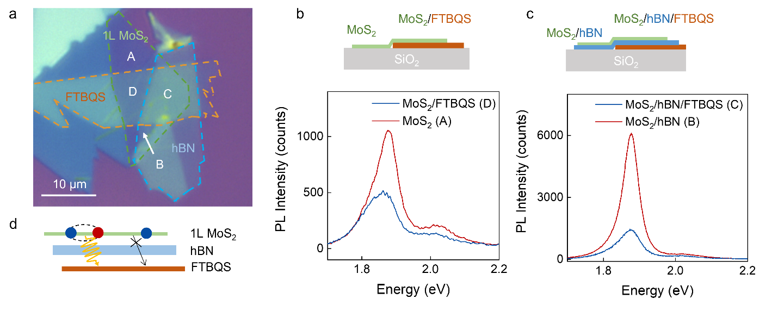
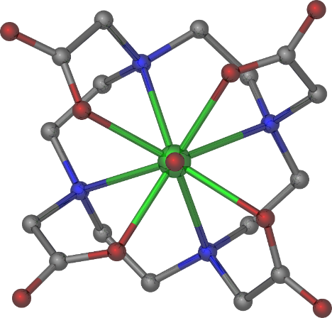
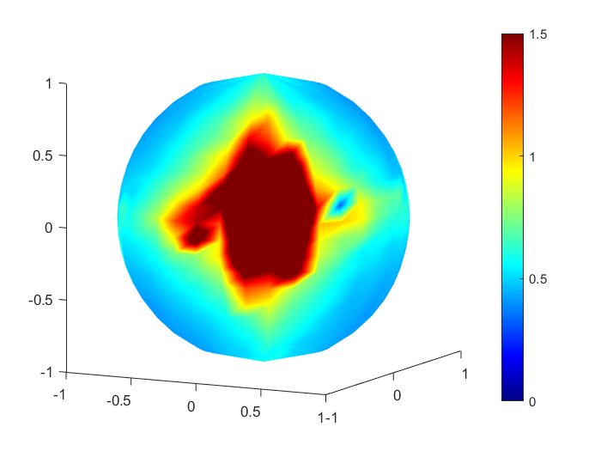
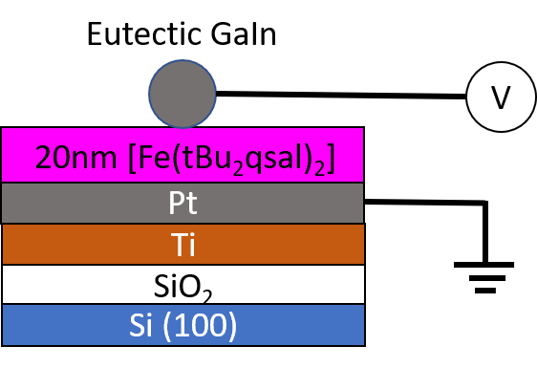
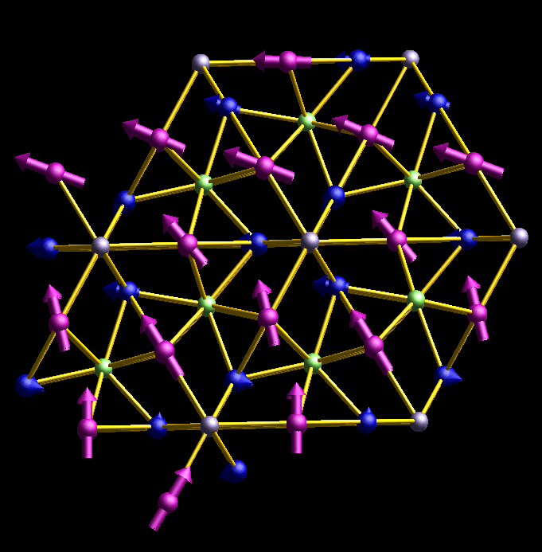
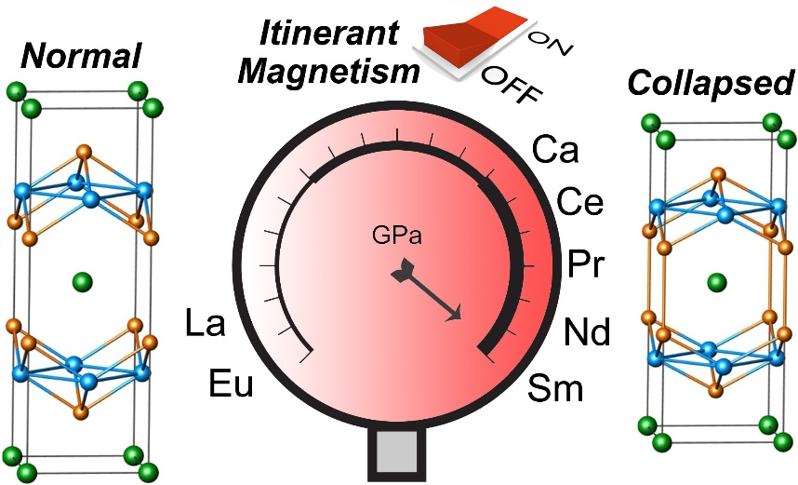
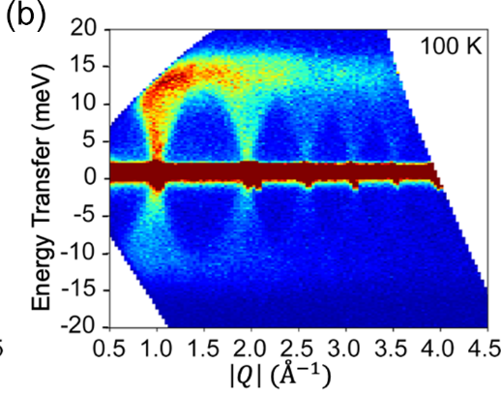
Inorganic Materials in the Shatruk Group
Spin-State Switching & Hybrid 2D Materials
Molecular Spin Qubits
B_{res}
Itinerant Magnetism & Magnetic Refrigeration
Unconventional Spin Textures

Slide 3
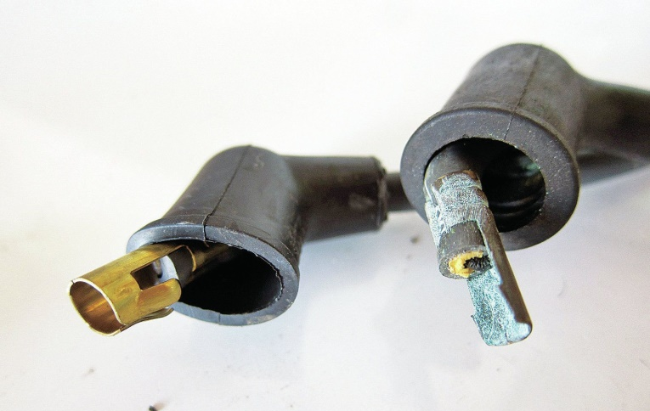
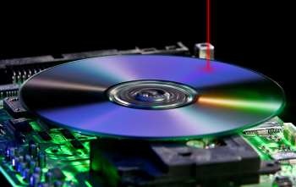
Motivation for Research
Electricity is a great thing, but…
  - electrical connections unavoidably add weight and mechanical constraints to the device architecture
  - wires corrode, requiring regular maintenance and/or replacement
Light as an alternative:
  - fibers don’t rust
  - the signal is transmitted
  with the speed of light
  - lower maintenance costs
  - opto-mechanical actuation
  - optical write/read-out

Slide 4
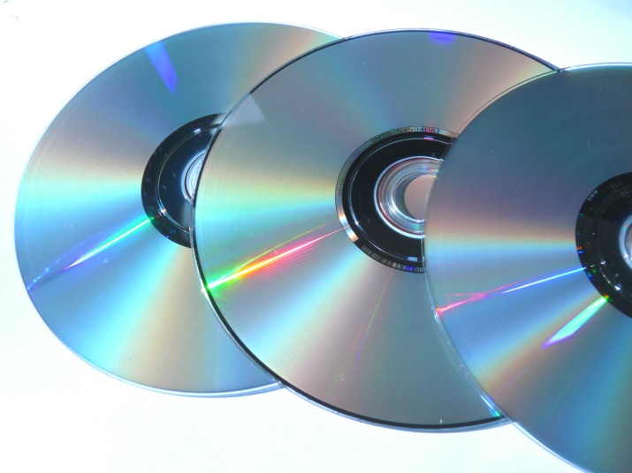
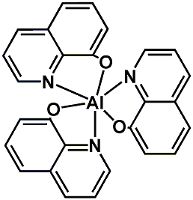
State of the Art
Extended-structure materials
  - doped semiconductors
  (Si, GaP, GaAs, etc.)
  - polymers (CD drives)
Molecular materials:
  - much higher storage density
  - light weight
  - high synthetic tunability
  - precise control over the photophysical properties
Alq3

Slide 5
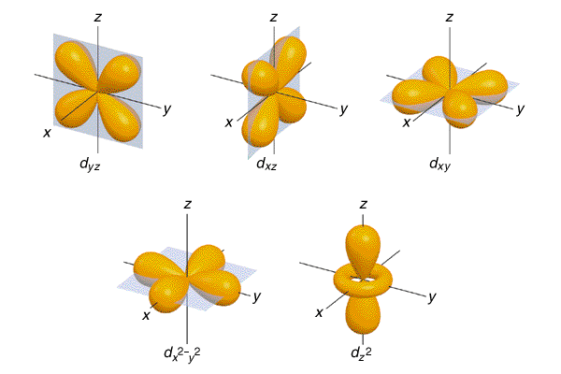
Splitting of d-Orbitals by Ligand Field
Octahedral symmetry
e_{g}
10Dq
M^{n+}, d
t_{2g}
Spectrochemical series of ligand-field strength:
I– < Br– < Cl– < SCN– < NO₃– < F– < OH– < H₂O < NCS– < py < NH₃ < en < NO₂– < PPh₃ < CN– < CO

Slide 6
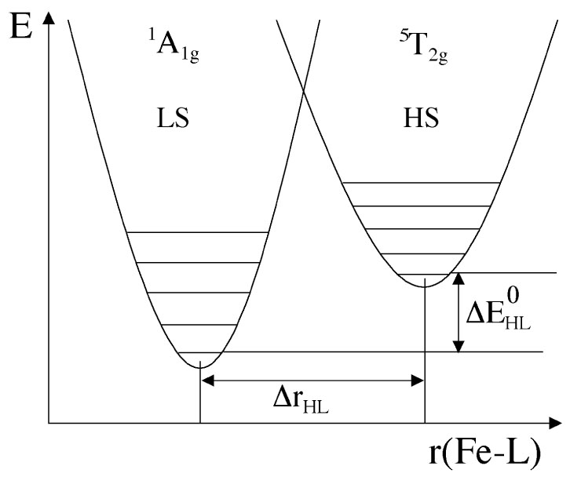
I. Spin Crossover (SCO)
e_{g}
e_{g}
Entropy driven transition
Observed for d⁴, d⁵, d⁶, d⁷ ions
Triggered by changes in temperature, pressure, or photoexcitation
t_{2g}
t_{2g}
LS, S = 0
HS, S = 2
Dramatic changes in:
- magnetic moment
- M-L bond lengths
- absorption spectrum (color)
Can we leverage the structural and optical changes that accompany SCO to create multifunctional materials?
Hauser, A. Top. Curr. Chem. 2004, 233, 49-58
Shatruk, M.; Phan, H.; et al. Coord. Chem. Rev. 2015, 289-290, 62-73

Slide 7
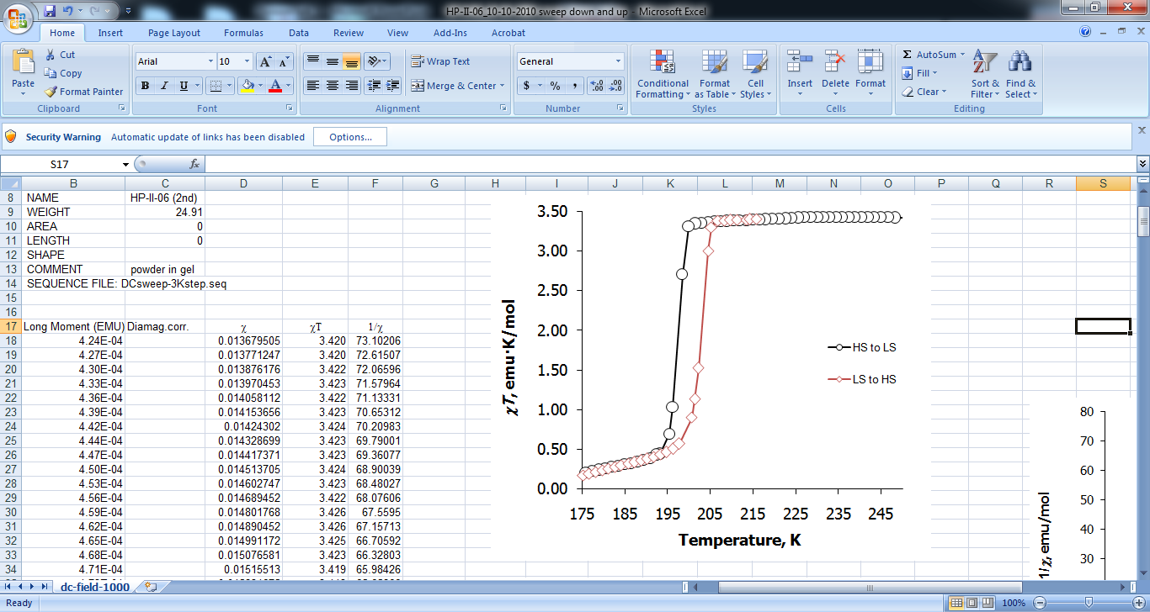
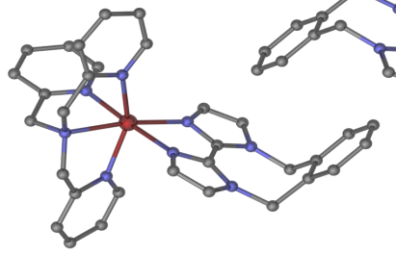
Example of Fe(II) SCO Complex
SCO with hysteresis (ΔT ~ 7 K)
HS
T_{1/2}↓ = 196 K
T_{1/2}↑ = 203 K
(ClO₄–)₂
LS
d(Fe-N)_{av}, Å
123 K (LS) | 210 K (HS)
2.002(4) | 2.184(4)

Slide 8
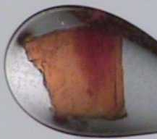
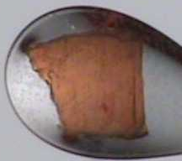
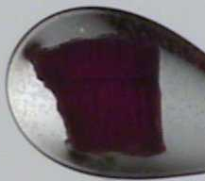
LS State Bleaching
[Fe(tpma)(xbim)](ClO₄)₂
(ClO₄–)₂
204K
190K
195K
210K
202K
205K
200K
The abrupt change in color due to drastically different optical properties of the HS and LS states

Slide 9
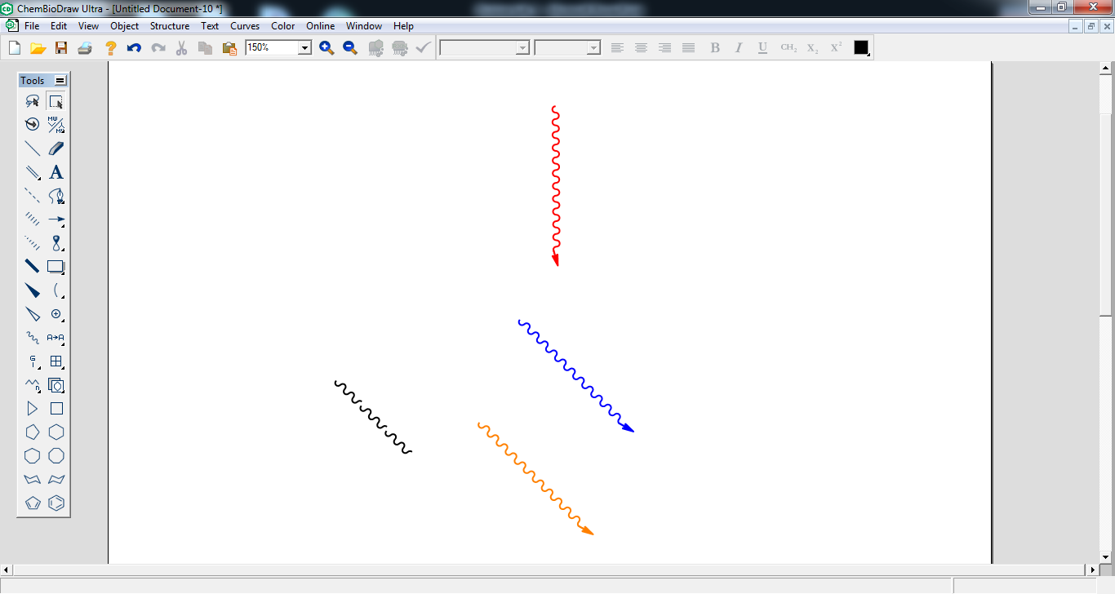
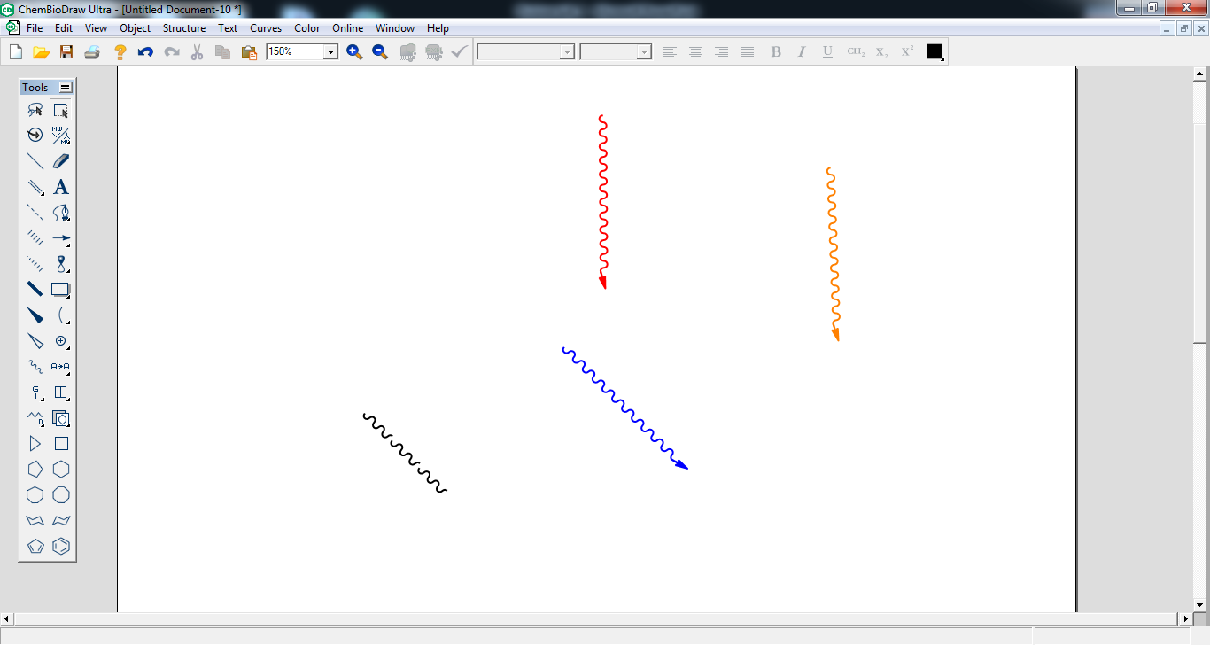
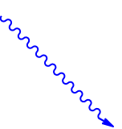
Photomagnetism (LIESST)
MLCT
Irradiation into characteristic absorption bands of the LS species results in a light-induced population of the HS state
Light-Induced Excited Spin-State Trapping (LIESST)
At sufficiently low temperature, the HS state will be trapped until it can acquire enough energy to undergo thermally activated relaxation to the LS state
¹T₂
¹T₁
³T₂
⁵E
³T₁
hν
⁵T₂
HS
¹A₁
LS
Electronic transitions
of Fe(II) SCO complexes

Slide 10
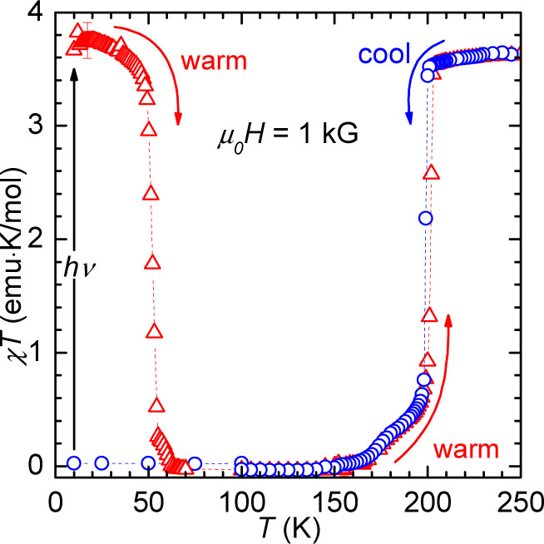
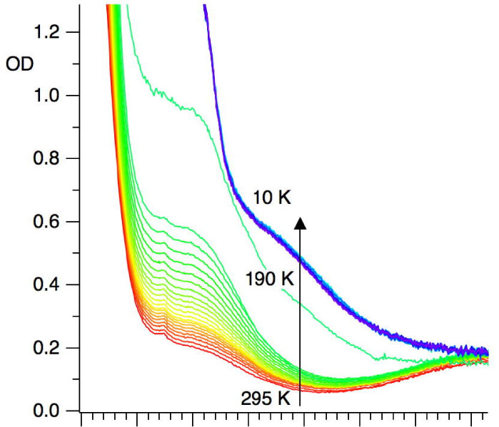
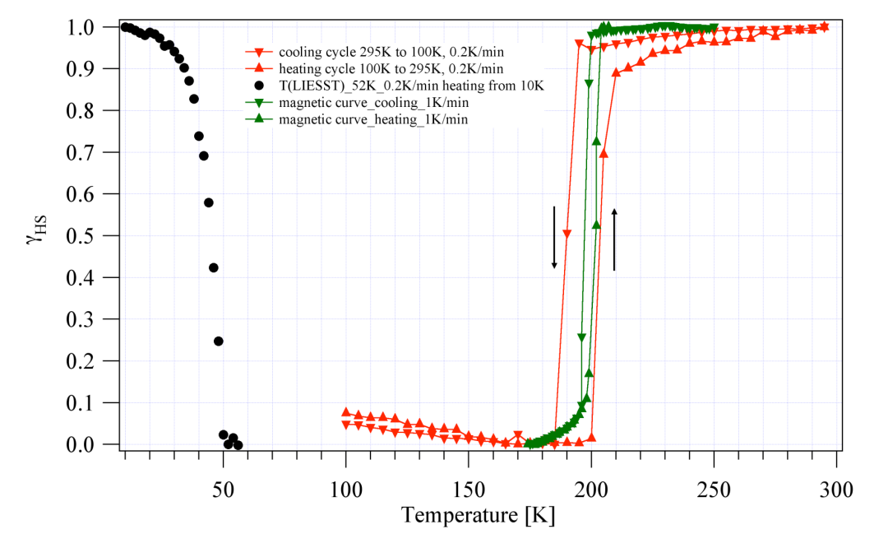
LIESST in [Fe(tpma)(xbim)](ClO₄)₂
(1)
(3)
SQUID
(ClO₄–)₂
(2)
(4)
UV-visible spectrum
Magnetic
Optical
hν
500 600 700 800 λ (nm)
Phan, H.; Chakraborty, P.; Calm, Y.; Chen, M.; Kovnir, K.; Keniley, L. K.; Hoyt, J. M.; Knowles, E. S.; Besnard, C.; Meisel, M.; Hauser, A.; Achim, C.; Shatruk, M. Chem. Eur. J. 2012, 18, 15805

Slide 11
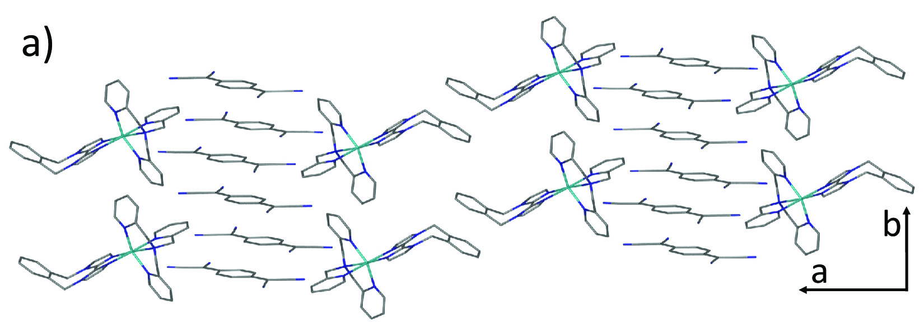
Combining SCO and Conductivity
DMF
[Fe^{II}(TPMA)(XBIM)]-(TCNQ)_{1.5}(ClO₄)·DMF
Phan, H.; Benjamin, S. M.; Steven, E.; Brooks, J. S.; Shatruk, M. Angew. Chem. 2015, 54, 823-827

Slide 12
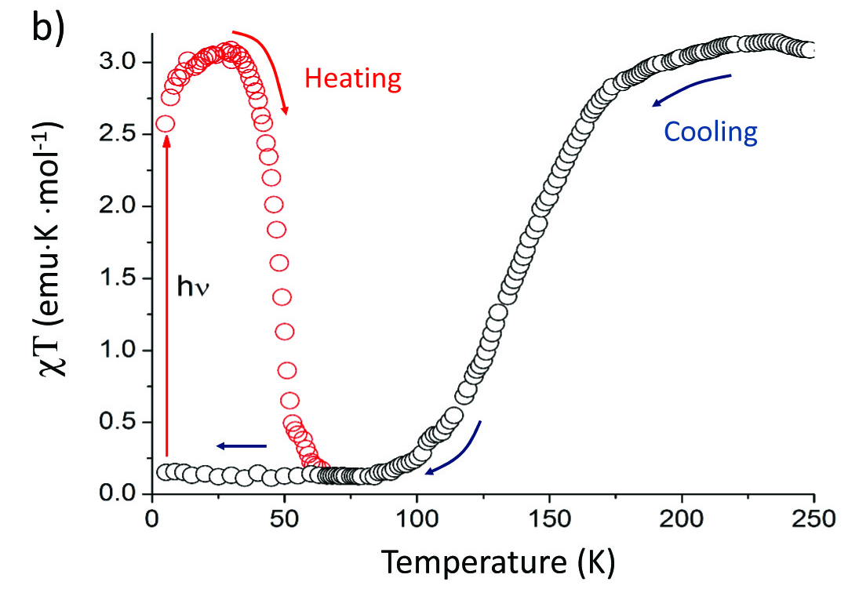
SCO, LIESST, and Conductivity
Conductivity at 300 K ~ 0.2 S/cm
For reference:
Semiconductors: 10^{–6} – 10¹ S/cm
“Bad” metals: 10¹ – 10³ S/cm
Phan, H.; Benjamin, S. M.; Steven, E.; Brooks, J. S.; Shatruk, M. Angew. Chem. Int. Ed. 2015, 54, 823-827

Slide 13
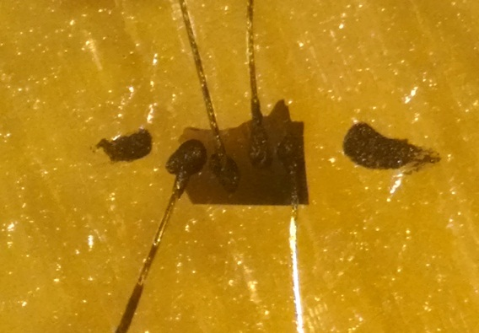
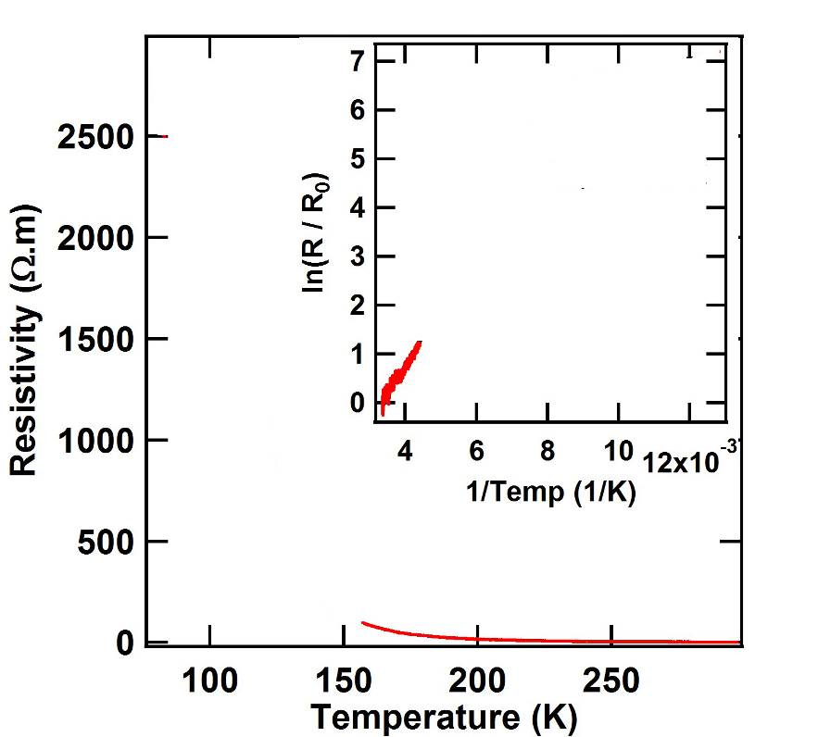
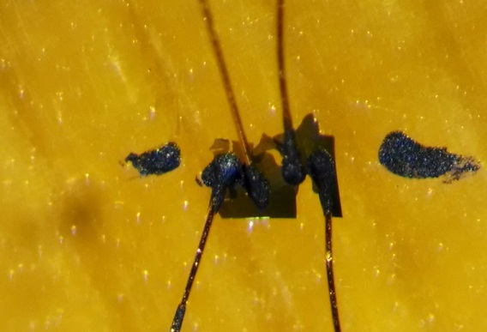
Conductivity Measurements
Tiny, brittle, and semi-
transparent crystals
12 μm gold wire
Fe(tpma)(xbim)]ClO₄(TCNQ)_{1.5}
Before Cooldown
After Cooldown
Carbon paste, 4-probe measurement

Slide 14
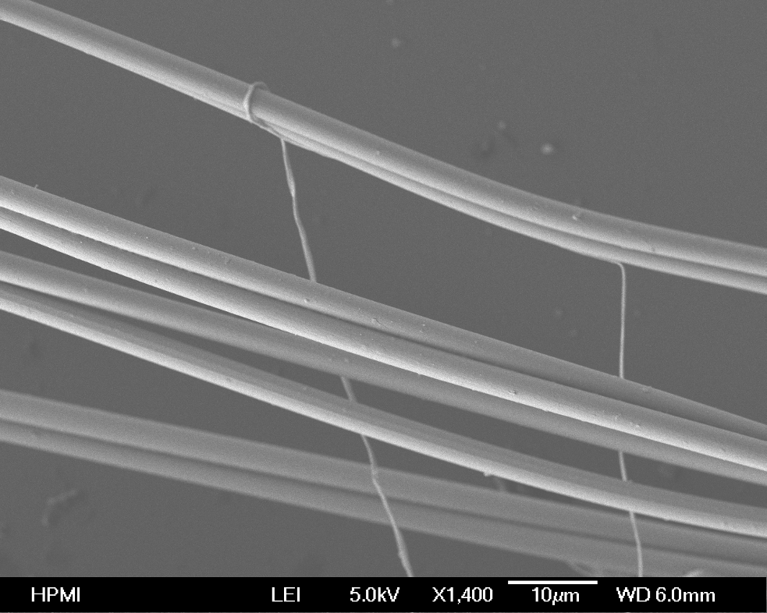
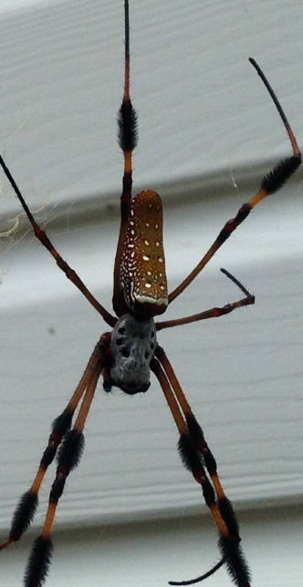
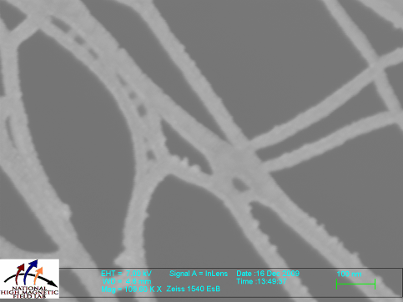
Nature to the Rescue!
Nephila Clavipes
4 μm
submicron
20 nm
21 nm Au is sputtered onto spider silk fibers, rendering them electrically conducting
The silk wires can be flexed but care should be taken not to over-stretch them
Steven E. et al., Sci. Technol. Adv. Mater. 2011, 12, 055002

Slide 15
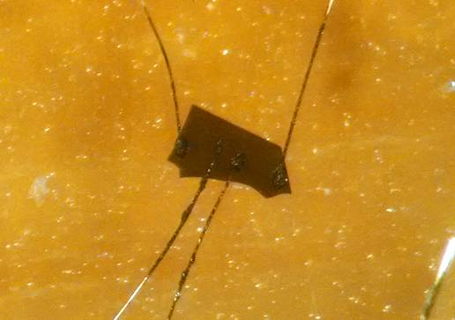
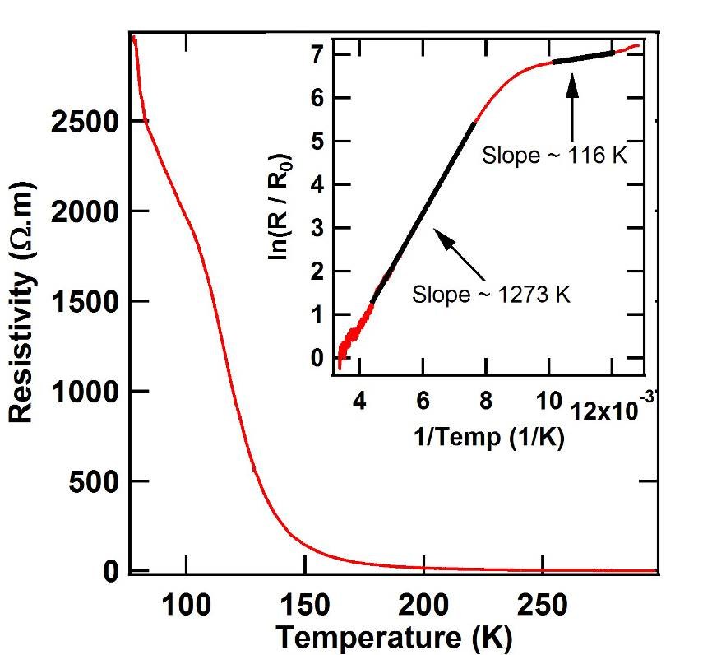
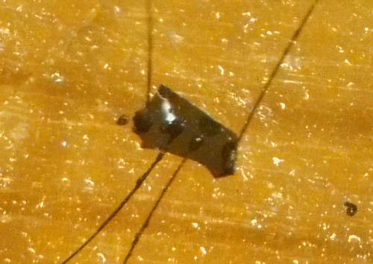
Conductivity Measurements
Tiny, brittle, and semi-
transparent crystals
4 μm spider silk wire
12 μm gold wire
Fe(tpma)(xbim)]ClO₄(TCNQ)_{1.5}
Before Cooldown
Before Cooldown
After Cooldown
After Cooldown
Carbon paste, 4-probe measurement

Slide 16
II. Ultrathin SCO Films
SCO nanoparticles on graphene
Deposited by contact printing from the surface of an ethyleneglycol droplet)
NP rods: l ~ 25 nm, d ~ 9 nm
Adapted from: Dugay, J.; Aarts, M.; Gimenez-Marques, M.; Kozlova, T.; Zandbergen, H. W.; Coronado, E.; van der Zant, H. S. J. Nano Lett. 2017, 17, 186-193

Slide 17
Depositing Molecules on Substrates
Source ⎯⎯→ | Solution | Gas Phase | Solid
Generality | High | Moderate | Low(?)
Scalability | High | Moderate | Moderate
Purity | Low | High | Moderate
Requirements
e-neutrality | n/a | ✓ | o
solubility | ✓ | n/a | n/a
volatility | n/a | ✓ | n/a
thermal stability | o | ✓ | o
surface stability | ✓ | ✓ | o
✓ = required o = desired

Slide 18
Gas-Phase Deposition of SCO Films
180 °C
10^{–8} mbar
237 °C
10^{–9} mbar
160 °C
10^{–9} mbar
100 °C
10^{–9} mbar
140 °C
10^{–8} mbar
190 °C
10^{–5} mbar
162 °C
10^{–2} mbar
217 °C
10^{–9} mbar
Kumar, K. S.; Ruben, M. Angew. Chem. Int. Ed. 2021, 60, 7502-7521

Slide 19
Gas-Phase Deposition of SCO Films
180 °C
10^{–8} mbar
237 °C
10^{–9} mbar
160 °C
10^{–9} mbar
100 °C
10^{–9} mbar
140 °C
10^{–8} mbar
190 °C
10^{–5} mbar
162 °C
10^{–2} mbar
217 °C
10^{–9} mbar
Kumar, K. S.; Ruben, M. Angew. Chem. Int. Ed. 2021, 60, 7502-7521

Slide 20
Gas-Phase Deposition of SCO Films
[Fe(H₂Bpz₂)₂(L₂)] (L₂ = bpy, phen)
Substrates: Si, glass, ITO-coated glass, polymer tape
Thickness: 400-500 nm
T_{1/2} similar to bulk
SCO more gradual
LIESST effect
Vacuum deposition
(10^{–2} mbar, 160-190 °C)
Methods:
UV-Vis spectroscopy
DFT
Adapted from: Naggert, H.; Quandt, E.; Tuczek, F.; et al. Dalton Trans. 2011, 40, 6364-6366

Slide 21
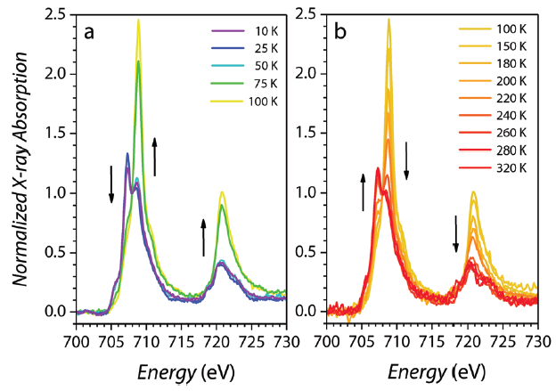
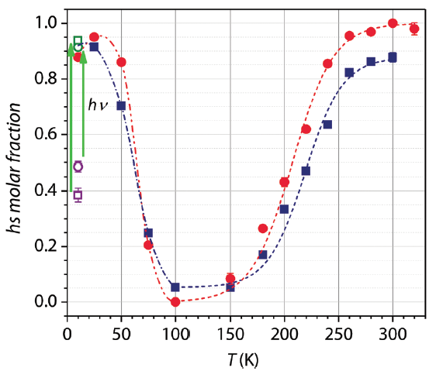
[Fe(qnal)₂] on Au(111)
Thickness: 300 nm
T_{1/2} similar to bulk
SCO more gradual
LIESST effect
Vacuum deposition
(10^{–8} mbar, 350 °C)
Methods:
UV-Vis, XAS
From XAS
Adapted from: Atrozi, M.; Sessoli, R.; Mannini, M.; et al. J. Mater. Chem. C 2018, 6, 8885

Slide 22

Molecular Design Challenge
Cooperativity: strong intermolecular interactions
Volatility: weak intermolecular interactions
Challenge: increase the volatility while preserving the abrupt spin transition
Solution: use asymmetric design by separating the cooperative and “volatilizing” functions
Criteria:
- neutral complexes
- easy synthetic modification
- asymmetric ligand structure
- only chelating (clamping) ligands
Miguel Gakiya

Slide 23

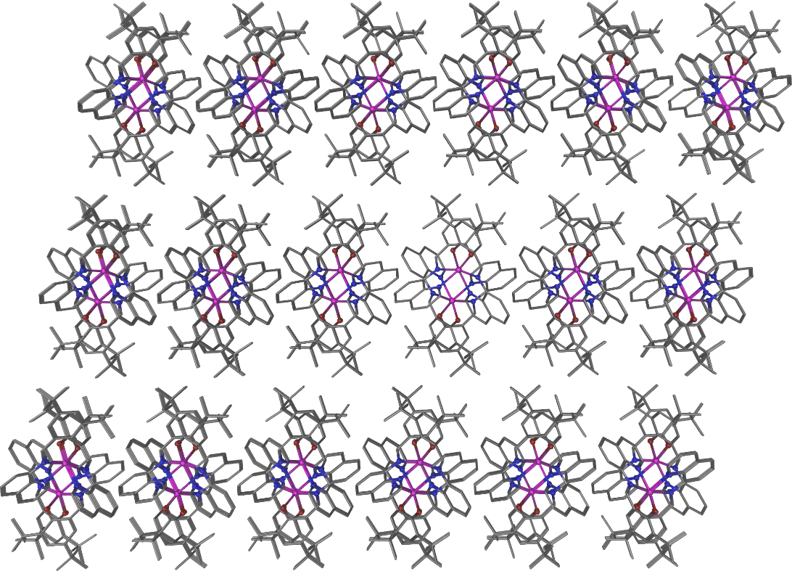
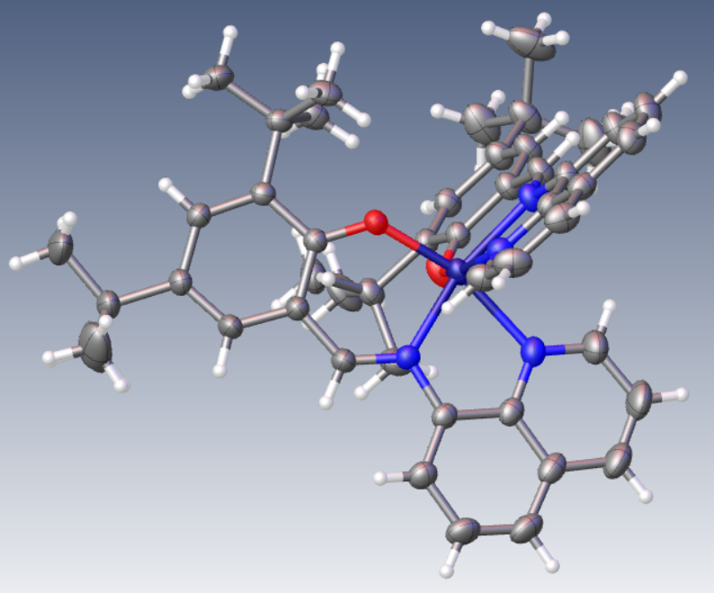
Synthetic Approach
Introduce the asymmetry of interactions to boost volatility
- the cooperativity will be preserved
- the volatility should be much higher
[Fe(tBu₂qsal)₂]
Gakiya-Teruya, M.; Jiang, X.; Le. D.; Rahman, T. S.; Hebard, A. F.; Shatruk, M.; et al. J. Am. Chem. Soc. 2021, 143, 14563-14572

Slide 24
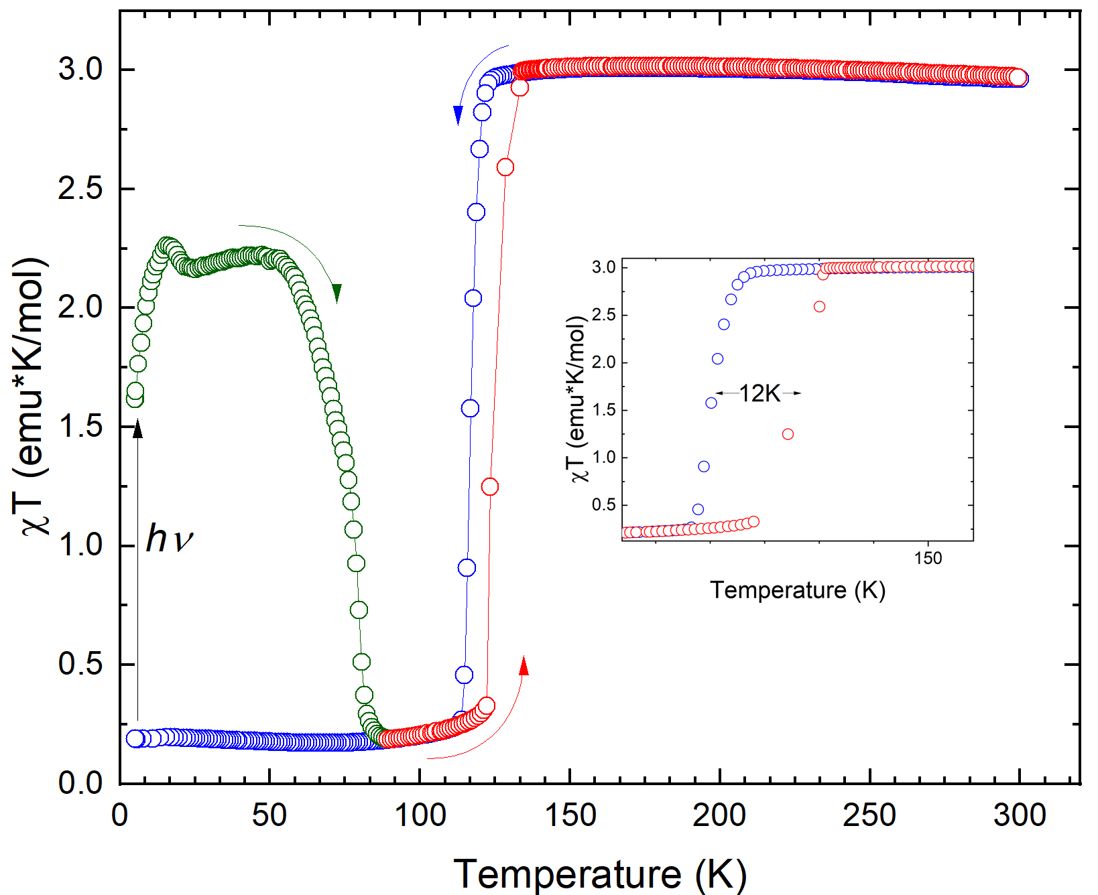
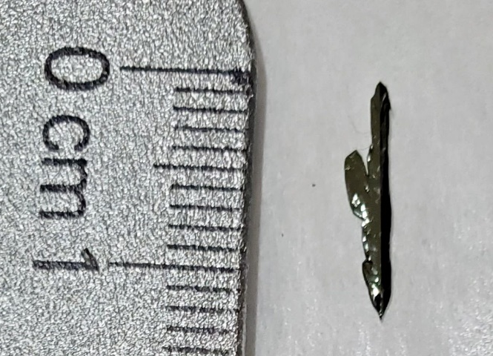
Properties of [Fe(tBu₂qsal)₂]
Crystals grown
by vapor transport at >10^{–5} mbar & 300 °C
T_{1/2} = 117 K / 129 K
T_{LIESST} = 84 K
Gakiya-Teruya, M.; Jiang, X.; Le. D.; Rahman, T. S.; Hebard, A. F.; Shatruk, M.; et al. J. Am. Chem. Soc. 2021, 143, 14563-14572

Slide 25
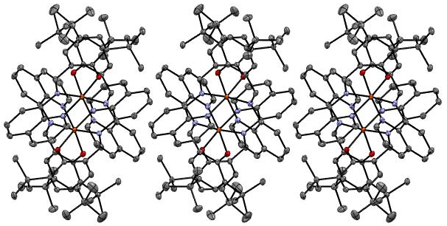

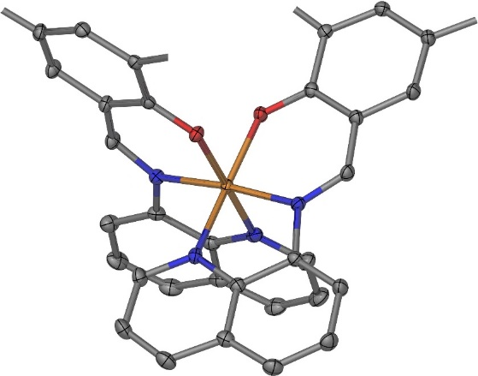
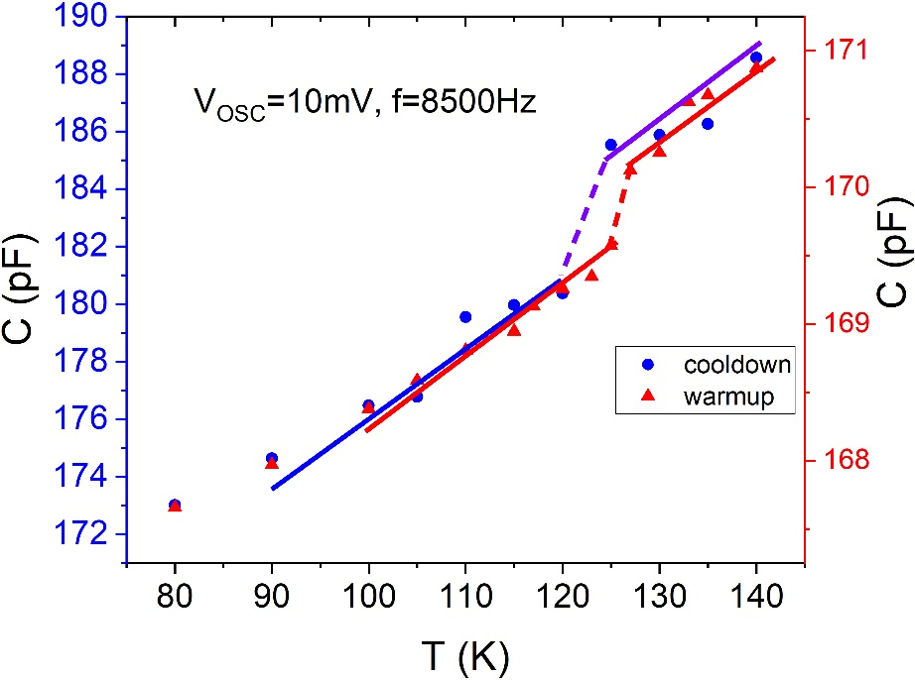
Thin-Film Capacitor
Sublimation
T_{1/2} ≈ 122 K / 127 K
Gakiya-Teruya, M.; Jiang, X.; Le. D.; Rahman, T. S.; Hebard, A. F.; Shatruk, M.; et al. J. Am. Chem. Soc. 2021, 143, 14563-14572

Slide 26
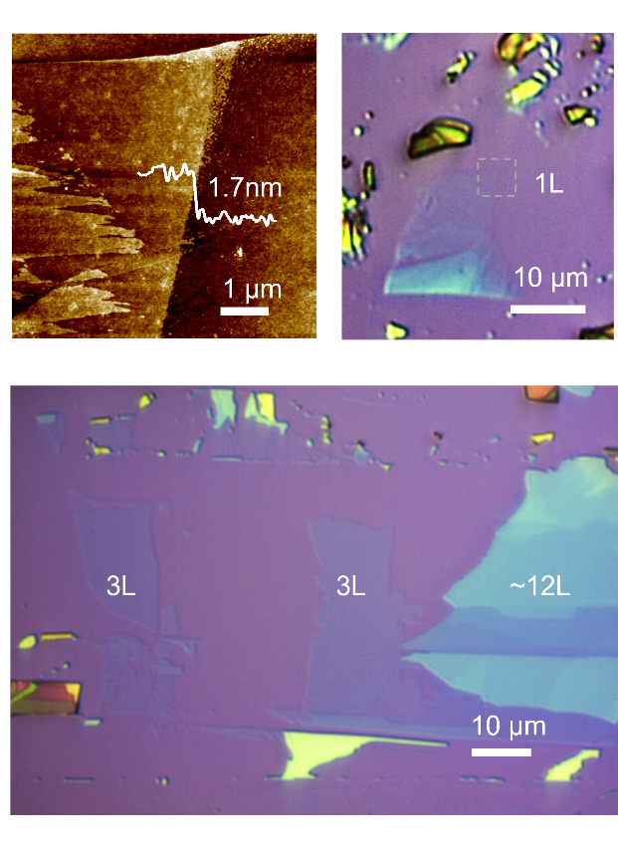
Mechanical Exfoliation
van der Waals gaps
Mechanical exfoliation:
Successful exfoliation down to a single molecular layer (1.7 nm thickness)
Koptur-Palenchar, J. J.; Gakiya-Teruya, M.; Shatruk, M.; Zhang, X. X; et al. Under Review

Slide 27
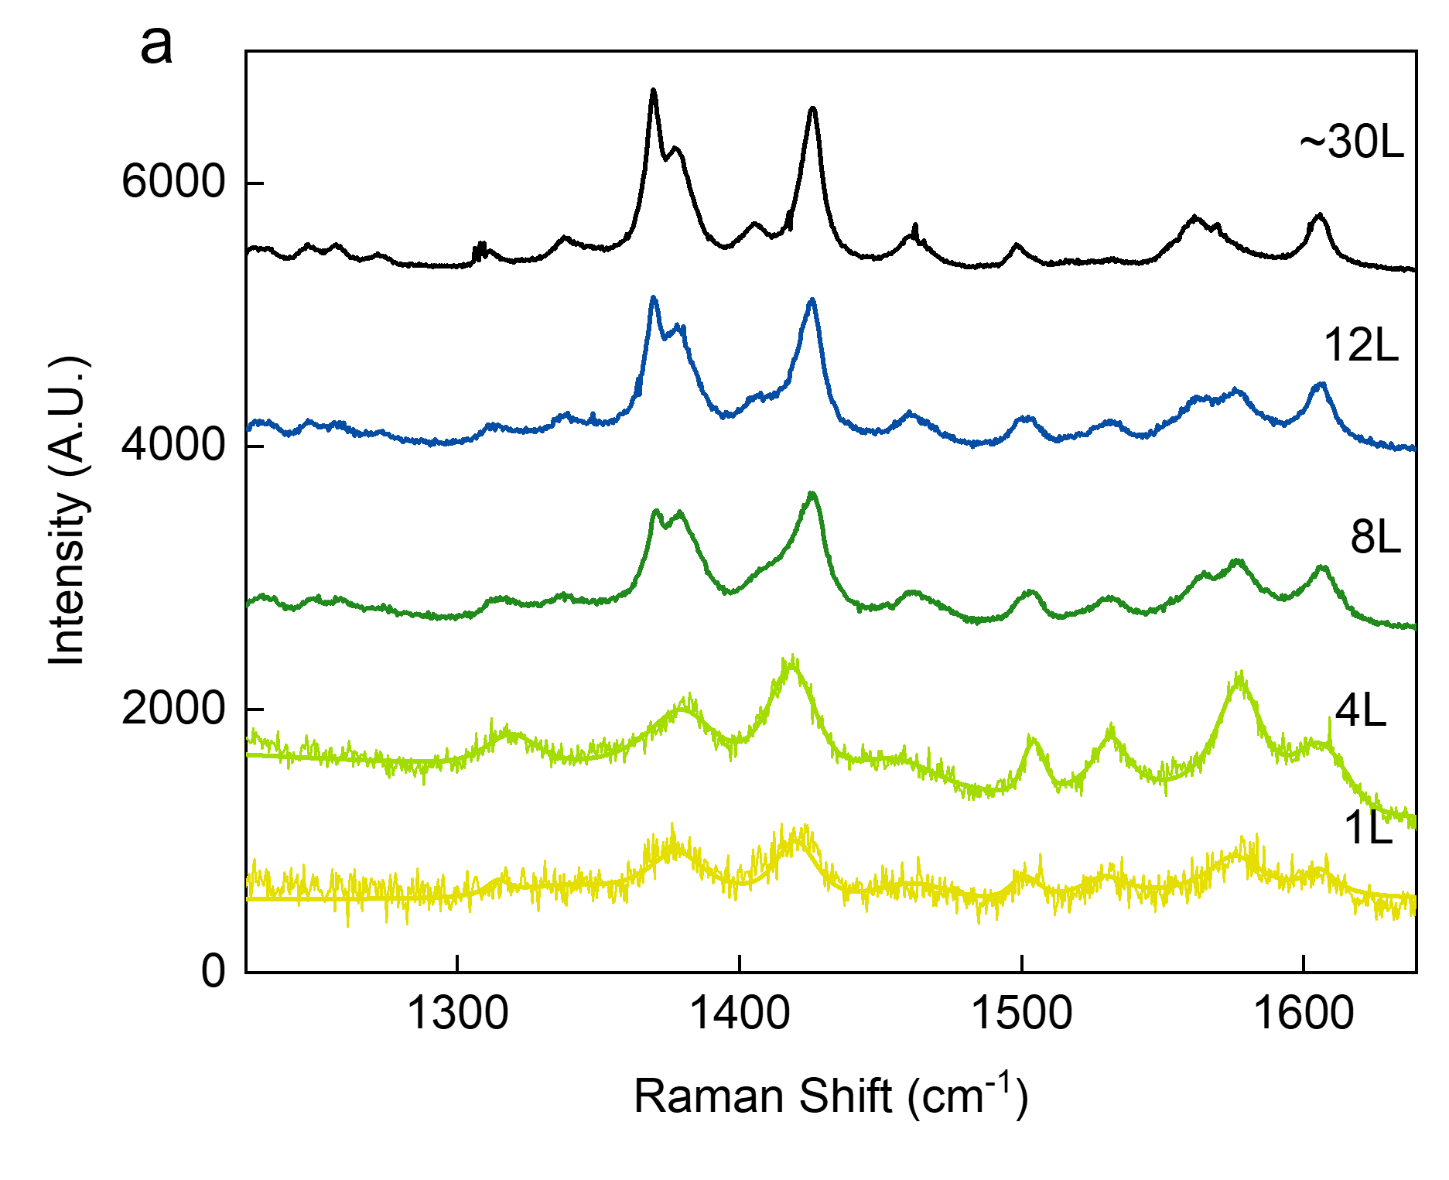
Mechanical Exfoliation
Mechanical exfoliation:
Successful exfoliation down to a single molecular layer (1.7 nm thickness)
Koptur-Palenchar, J. J.; Gakiya-Teruya, M.; Shatruk, M.; Zhang, X. X; et al. Under Review

Slide 28
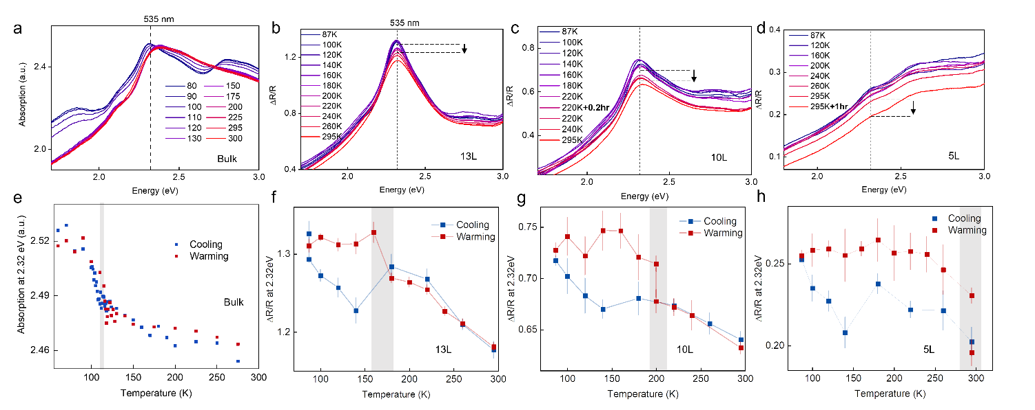
Thickness Dependence of SCO
The normalized reflection contrast measurements suggest increased hysteresis in the 2D SCO material
Bulk
13 L
10 L
5 L
Koptur-Palenchar, J. J.; Gakiya-Teruya, M.; Shatruk, M.; Zhang, X. X; et al. Under Review

Slide 29
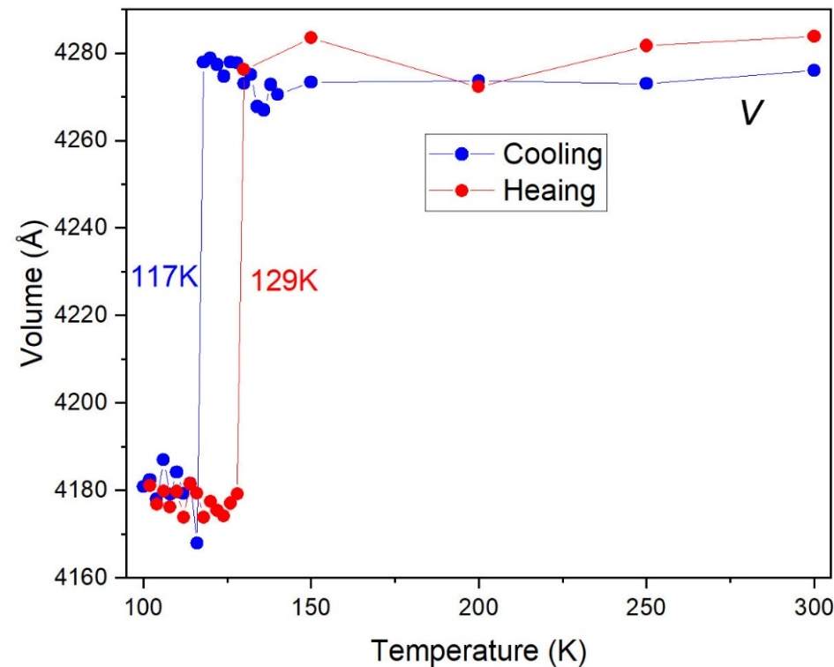
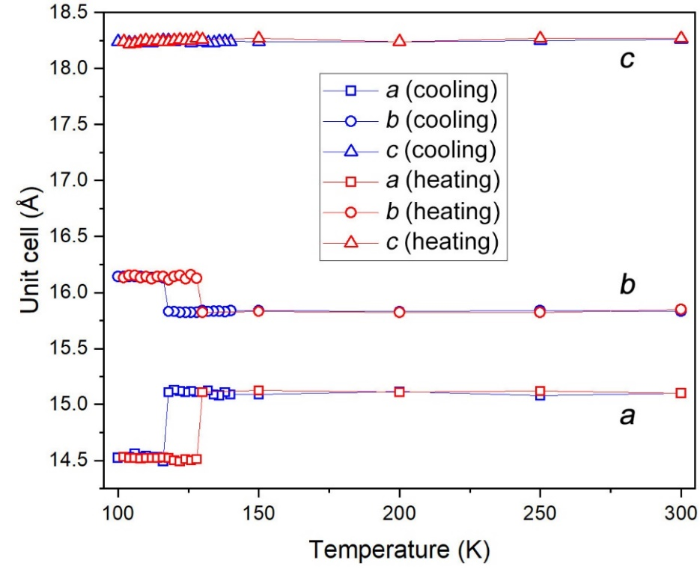
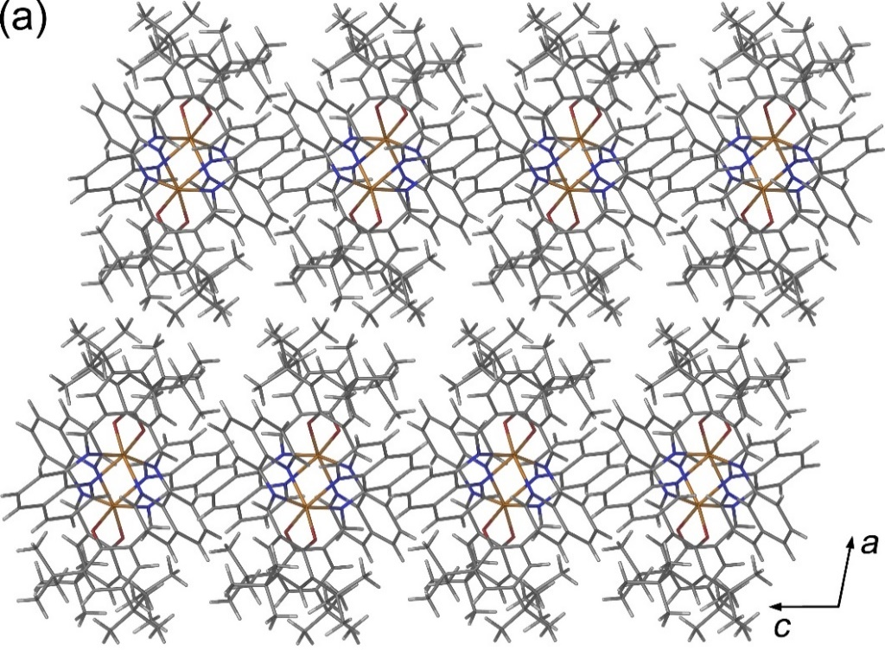
Thickness Dependence of SCO
# of layers | ΔT_{1/2}
Bulk | 12 K
13 | ~45 K
10 | ~90 K
5 | ~200 K
Hypothesized reason:
Interfacial strain combined with the restriction of domain wall motion
Koptur-Palenchar, J. J.; Gakiya-Teruya, M.; Shatruk, M.; Zhang, X. X; et al. Under Review

Slide 30
2D Heterostructures
Assembled by the PDMS stamp method
Koptur-Palenchar, J. J.; Gakiya-Teruya, M.; Shatruk, M.; Zhang, X. X; et al. Under Review

Slide 31
2D Heterostructures
Assembled by the PDMS stamp method
Charge transfer blocked by hBN
The Förster energy transfer still allowed
Koptur-Palenchar, J. J.; Gakiya-Teruya, M.; Shatruk, M.; Zhang, X. X; et al. Under Review

Slide 32


What’s Next?
Investigating heterostructures
Tuning the SCO temperature
d(N–N)
in the free, non-coordinated ligand
(experimental or calculated values)
Phan, H.; Hrudka, J. J.; Igimbayeva, D.; Lawson Daku, L. M.; Shatruk, M. JACS 2017, 139, 6437-6447

Slide 33
Summary
Using the principle of asymmetric design,
we can engineer increased volatility of materials while preserving the abrupt SCO
The structural hierarchy allows mechanical exfoliation of ultrathin SCO flakes
Future Efforts
Elucidating the role of substrates
Extending the approach to other types of magnetic molecules (SMMs, radicals)
Investigation of heterostructures and devices with inorganic 2D materials

Slide 34




The Team
Prof. Hoa Phan
Dr. Dibya Jyoti Mondal
Sandu Yergeshbayeva
Miguel Gakiya-Teruya
Govind Sasi Kumar
Ian Campbell
Victoria Li
Shubham Bisht
Milo Adams
Samuel Adegboyega
Divya Kumar
Eduardo Hernandez
Gerald Ciani
Gia Rivers
Funding
Collaborators
Prof. Stephen Hill
and Robert Stewart
(Florida State)
Prof. Arthur Hebard
and Juanyuan Xiang;
Prof. Xiao-Xiao Zhang
and John Koptur-Palenchar
(University of Florida)

